Slide 1

WESLEYAN UNIVERSITY
Flexible Spending Accounts
How FSAs benefit you and your family
Helpful tips and a few rules
Tools to help use your accounts

Slide 2
Why Choose an FSA?
FSA Tax Savings Estimator
 | Without an Account | With Both Accounts
Annual Salary | $ 36,000 | $ 36,000
Weekly Gross Pay | $ 692 | $ 692
FSA Account Contributions Per Week | $ 0 | Healthcare $ 25 Childcare $ 96 Total $ 121
Taxable Wages | $ 692 | $ 571
Estimated Tax Rate 32% FICA 7.65%, Federal 20%, State 5% | $ 226 | $ 186
Expenses Paid for After Tax | Healthcare $ 25 Childcare $ 96 Total $ 121 | $ 0
Net Pay | $ 345 | $ 385
Annually | $ 17,940 | $ 20,020
Total Tax Savings with FSAs $ 2,080
Tax Savings!
FSAs save you about 30% on products and services you and your family use every day*.
Make pretax payroll contributions to your FSA and pay no income tax on the money set aside for eligible expenses.
Use your FSA to pay for prescriptions, copays, over-the-counter medicine, dental exams, daycare, and more.
*based on 30% tax bracket

Slide 3
How Does It Work?
Step 1. Plan Ahead
Decide how much money to set aside in your FSA based on you and your family’s predictable and manageable expenses for the year, up to the maximum. Access your full Medical FSA election from day one.
Step 2. Make an Election for Pre-Tax Payroll Deductions
Your election will be deducted on a pre-tax basis each pay period in equal increments during the plan year.
Step 3. Use your FSA to Pay for Eligible Expenses
Use your debit card or File claims through the GDI website, email, fax or mail. Your FSA pays for eligible expenses that would have bought anyway, but FSA funds are tax-free! It’s like getting a discount on every purchase.
Step 4. Know How It Works
Understand the benefits, eligibility and rules of each type of account. Let’s take a closer look.

Slide 4
Different Types of FSAs
Medical FSA (Traditional)
A general purpose, traditional medical FSA covers all eligible medical, vision and dental expenses allowed under IRS Code Section 213(d).
If you are eligible for the group health plan, and you or your spouse do not contribute to an HSA, you are eligible for a Medical FSA.
Dependent Care FSA
Save on the cost of eligible dependent care for children up to age 13 while you and your spouse (if married) are working or attending school.

Slide 5
Understanding Medical FSAs
Common FSA Eligible Expenses
Over-the-Counter Medicines
Menstrual products
Copays
Prescriptions
Deductible, Coinsurance
First Aid
Dental and Vision Visits
Vision correction surgery
Glasses, Contacts & Supplies
Smoking cessation
Chiropractic care
Orthodontia
Not Eligible
Service Plans or Warrantees
Gym Memberships
Cosmetic Services
Elect up to $3,200 (pending IRS increase to $3,200) maximum for the 2024 FSA/Calendar Plan Year
Includes eligible medical, dental or vision expenses
Access to your entire annual election at anytime during the year
Use your FSA for yours and your family’s expenses
Spouse, children to age 26 even if not claimed on your tax return, domestic partners must be claimed as tax dependent
Once you make an election, you cannot change it unless you have a qualifying life event
Know your deadlines and Final Filing Date for claims
Unused funds will be forfeited
Specific rules are included in your enrollment materials and in your plan’s Summary Plan Description

Slide 6
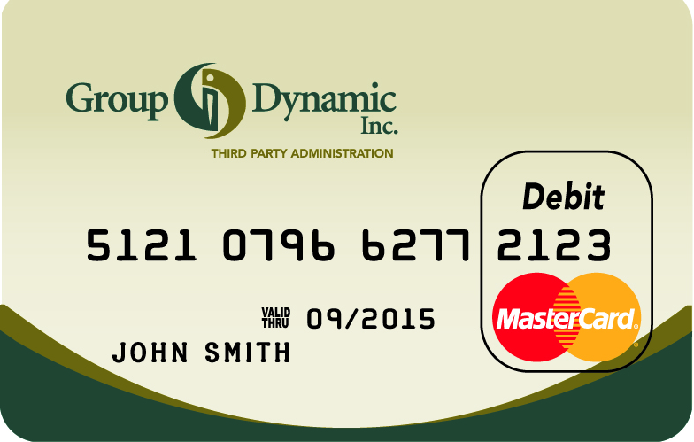
Using Your Medical FSA Debit Card
Tips to Avoid Deactivation
Pay attention to your purchases
Always keep your receipts
Share this information with family members
Download the GDI Mobile App
Access the Participant Portal to check for notifications
Manage your portal notification preferences
Don’t use the card it you suspect an expense will require a receipt. Use a different form of payment and submit a request for FSA reimbursement instead
Dental & Vision visits often require receipts
The GDI Debit Card
Your debit card is funded with your entire
election, just swipe to make eligible purchases
Built-in intelligence allows most retailers to identify eligible expenses at the point of sale, eliminating the need to substantiate each card swipe
Save all receipts! GDI may request a copy of a receipt to substantiate a purchase, this is how GDI can ensure a charge is eligible – please review the card substantiation materials!
Debit cards are suspended when GDI cannot substantiate a transaction within 40 days. We are required by the IRS to deactivate a card until a receipt is reviewed and the charge is determined to be eligible

Slide 7

Understanding Dependent Care FSAs
Annual Maximum Contributions 2023: $5,000 Single Parent or Married, filing jointly
$2,500 Married parents who file separately
Reimbursements are limited to the balance in your account
Compare FSA tax savings to Federal Childcare Tax Credit, FSA may offer greater tax savings
Eligible children up to 13th birthday while parent(s) are working
Eligible adult who is your dependent who requires daycare
Most commonly a disabled spouse or child over age 13
Eligible care providers will provide you with a tax ID number or SSN
No tax-free “under the table” payments to care providers
GDI’s Automated Dependent Care Reimbursement program saves you from the hassle of filing claims throughout the plan year
Election changes are permitted when you have changes in cost, location, provider or when you no longer need the care
You will need to complete IRS Form 2441 when you file your annual federal tax return
You must be the custodial parent to elect Dependent Care FSA
Common Eligible Expenses
Daycare center
Before or Afterschool Program
Day Camps
Au Pair or Nanny
Not Eligible
Tuition
Deposits on future services
Overnight camps
Under-the-table payments

Slide 8
Use it Or Lose It? The Wesleyan U FSA GRACE PERIOD
The IRS determines FSAs are Use-it-or-Lose-It accounts. That means funds you do not use by the end of the plan year are forfeited by you. Don’t let this happen! The following features offer relief from Use-it-or-Lose-It and help you make the best use of your FSA tax savings.
Plan Year Dates
Determined by your employer, it is the date range that defines your FSA election period and when eligible expenses can be incurred.
Grace Period
A period of time (In the case of Wesleyan – 2 ½ months) after the plan year ends when you can continue to incur expenses.
This means you have until March 15th, 2024, to clean out your 2023 FSA.
Runout Period
The period of time (in the case of Wesleyan – 105 days) after the plan year ends when you can still submit expenses you incurred during the plan year.
This means you have until April 15th, 2024, to submit claim expenses for reimbursement.

Slide 9
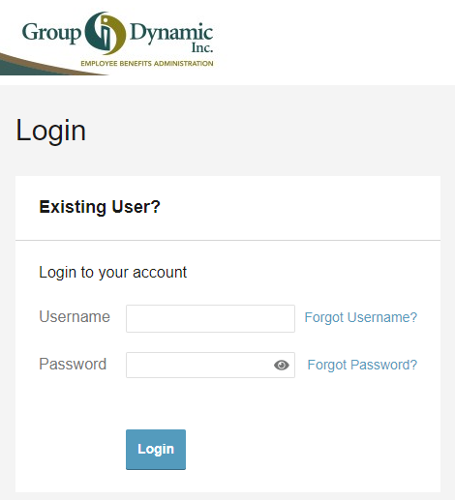
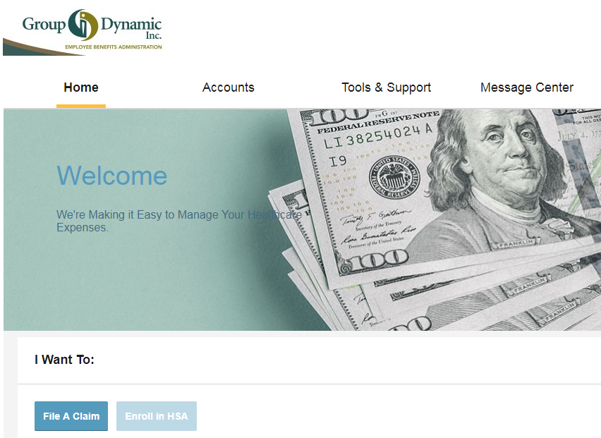
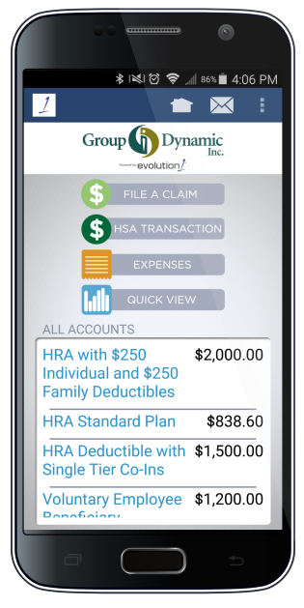
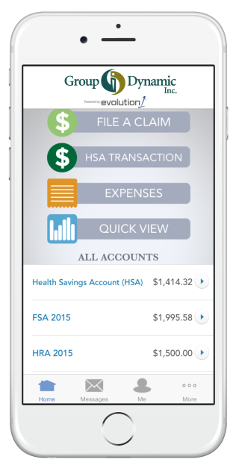
Tools to Help You Manage Your FSAs
The Participant Portal
Total account management available on the portal:
Check account balances
File claims and upload receipts
View transactions and claim history
Download forms
Set up Notification preferences for alerts regarding denials, requests for receipts, card status
Set up Direct Deposit
Access the Participant Portal
Go to www.gdynamic.com
Select Log In
The Mobile App
Access your account from your phone or tablet
Download our free GDI app
Use the camera to upload receipts
Set mobile text alerts for account updates

Slide 10

Convenient Filing Options
Reimbursement Requests are processed weekly!
Requests received by noon on Tuesday, a check or direct deposit occurs on Thursday.
Use your GDI debit card
File via the participant portal at www.gdynamic.com/portal
Email a claim to GDI: claims@gdynamic.com
Fax a claim to GDI: 207-518-5200
Call GDI’s Reimbursement Services Team for help at 800-626-3539

Slide 11
Your FSA Plan
WESLEYAN UNIVERSITY FSA Plan Includes the following provisions:
Plan Year Dates
January 1 to
December 31
Medical FSA
Max: $3,200 (subject to final IRS announcement)
Includes Debit Card
Dependent Care FSA
Elections
Max: $5000
Max: $2500 Married, file separately
Runout Period
105 days after December 31
to submit claim expenses for reimbursement (April 15)
Grace Period
Dependent Care FSA
2 ½ months after December 31
to incur expenses (March 15)
Grace Period
Medical FSA
2 ½ months after December 31
to incur expenses (March 15)

Slide 12

Thank you for your time.
Group Dynamic, Inc.
411 US Route 1 · Falmouth · ME · 04105

